Slide 1
Analysis of Movies Data for Microsoft’s Movie Studio
AGENDA:
Introduction
Key Findings
Relating Findings to Business Objectives
Generating Actionable Insights
Prioritizing Insights
Conclusion
References

Slide 2
Introduction
Purpose of Analysis
Explains the overarching goal of the analysis, such as informing decision-making or identifying trends.
Clarifies how the analysis aligns with Microsoft's strategic objectives in the film industry.
Data Sources (TMDb)
Describes the primary data source, The Movie Database (TMDb), including its significance in the context of movie analytics.
Highlights key attributes of the data, such as movie titles, ratings, genres, and release dates.
Analysis Goals
Outlines specific objectives or questions the analysis aims to address, such as understanding audience preferences, identifying successful movie attributes, or exploring market trends.
Provides a roadmap for the subsequent sections of the analysis.

Slide 3
Key Findings
Distribution of Vote Counts
Right-skewed Distribution
Indicates that most movies have low vote counts, with only a few receiving high counts.
Implications for Audience Engagement
Shows varying audience engagement levels.
Movies with higher counts likely have stronger audience appeal.
Helps Microsoft identify audience preferences for tailored content strategies.

Slide 4
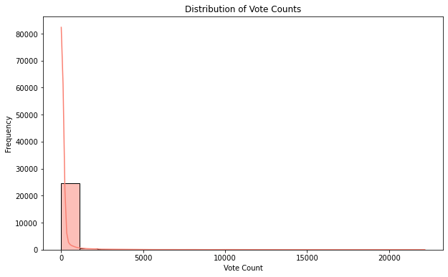
Distribution of Vote counts This histogram illustrates the distribution of vote counts among movies in the dataset. We observe that the majority of movies have lower vote counts, with a long tail indicating a few movies with significantly higher vote counts.

Slide 5
Key Findings (continued)
2. Distribution of Popularity
Variability in Popularity Scores
Indicates differences in audience reception and interest.
Presence of Highly Popular Movies
Highlights the existence of movies with exceptionally high popularity scores.
Implications for Content Strategy
Allows Microsoft to identify successful movie characteristics.
Guides the creation of content that resonates with audiences.

Slide 6
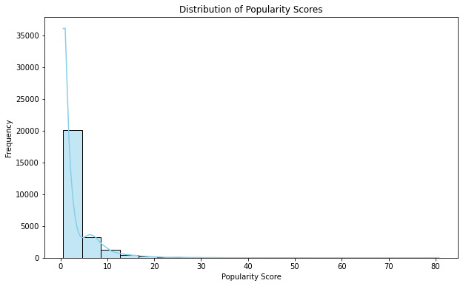
Distribution of Popularity This histogram illustrates the distribution of popularity scores among movies in the dataset. We observe variability in popularity scores, with a long tail indicating the presence of highly popular movies.

Slide 7
Key Findings (continued)
3. Correlation Analysis
Moderate Positive Correlation between Popularity and Vote Count
Indicates that movies with higher popularity tend to receive more votes.
Weak Correlations with Vote Average
Suggests that vote average has limited impact on other variables.
Implications for Marketing Strategies

Slide 8
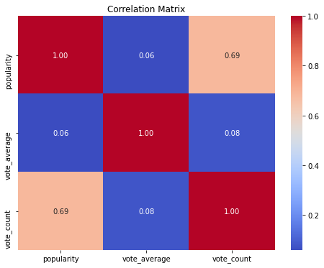
Correlation Analysis(Figure) The heatmap below displays the correlation matrix between popularity, vote average, and vote count. We observe a moderate positive correlation (0.685) between popularity and vote count, suggesting that movies with higher popularity tend to have more votes. Other correlations, such as between vote count and vote average (0.079), are relatively weak.

Slide 9
Relating Findings to Business Objectives
1.Understanding Audience Engagement:
The analysis of vote counts provides insights into audience engagement with movies. This information can help Microsoft's movie studio understand which movies resonate most with viewers and potentially replicate their success.
2.Identifying Popular Movies:
The examination of popularity scores helps identify movies that have a significant impact on audiences. By understanding the characteristics of these popular movies, Microsoft can tailor their content strategy to create similarly successful films.
3.Assessing Correlations:
The correlations between variables such as popularity, vote count, and vote average provide insights into how these factors relate to each other. Understanding these relationships can inform decision-making regarding marketing strategies, content creation, and audience targeting.

Slide 10
Generating Actionable Insights
1.Invest in Audience Engagement:
Microsoft should prioritize creating content that drives high audience engagement, as reflected in vote counts. This may involve focusing on genres or themes that elicit strong emotional responses or resonate with specific demographics.
2.Emphasize Popularity Drivers:
By analyzing characteristics shared by highly popular movies, Microsoft can identify key factors that contribute to audience appeal. This could include casting popular actors, leveraging established franchises, or creating compelling marketing campaigns.
3.Optimize Marketing Efforts:
Given the moderate correlation between popularity and vote count, Microsoft should consider investing in marketing initiatives that boost a movie's visibility and appeal. Targeted advertising campaigns, social media promotions, and partnerships with influencers could help increase a movie's reach and engagement.

Slide 11
Prioritizing Insights
1.Audience Engagement:
Given its importance in driving overall movie success, prioritizing efforts to enhance audience engagement should be a top priority for Microsoft.
2.Identifying Popular Movies:
Understanding the characteristics of highly popular movies can inform content creation strategies and help Microsoft allocate resources effectively.
3.Optimizing Marketing:
Investing in marketing initiatives that capitalize on the relationship between popularity and vote count can maximize the impact of Microsoft's promotional efforts.

Slide 12
Conclusion
The analysis of movie data provides valuable insights for Microsoft's movie studio. By examining vote counts, popularity scores, and correlations between variables, we have gained a deeper understanding of audience engagement, movie popularity, and key drivers of success. These insights can inform strategic decision-making and help Microsoft create content that resonates with viewers, optimize marketing efforts, and maximize the impact of its movie productions.

Slide 13
References
The Movie Database (TMDb): https://www.themoviedb.org/
Seaborn Documentation: https://seaborn.pydata.org/
Matplotlib Documentation: https://matplotlib.org/
Pandas Documentation: https://pandas.pydata.org/
NumPy Documentation: https://numpy.org/

